Slide 1
buffer
buffer
mode="point"
mode="face"

Slide 2
outside
current
expected

Slide 3
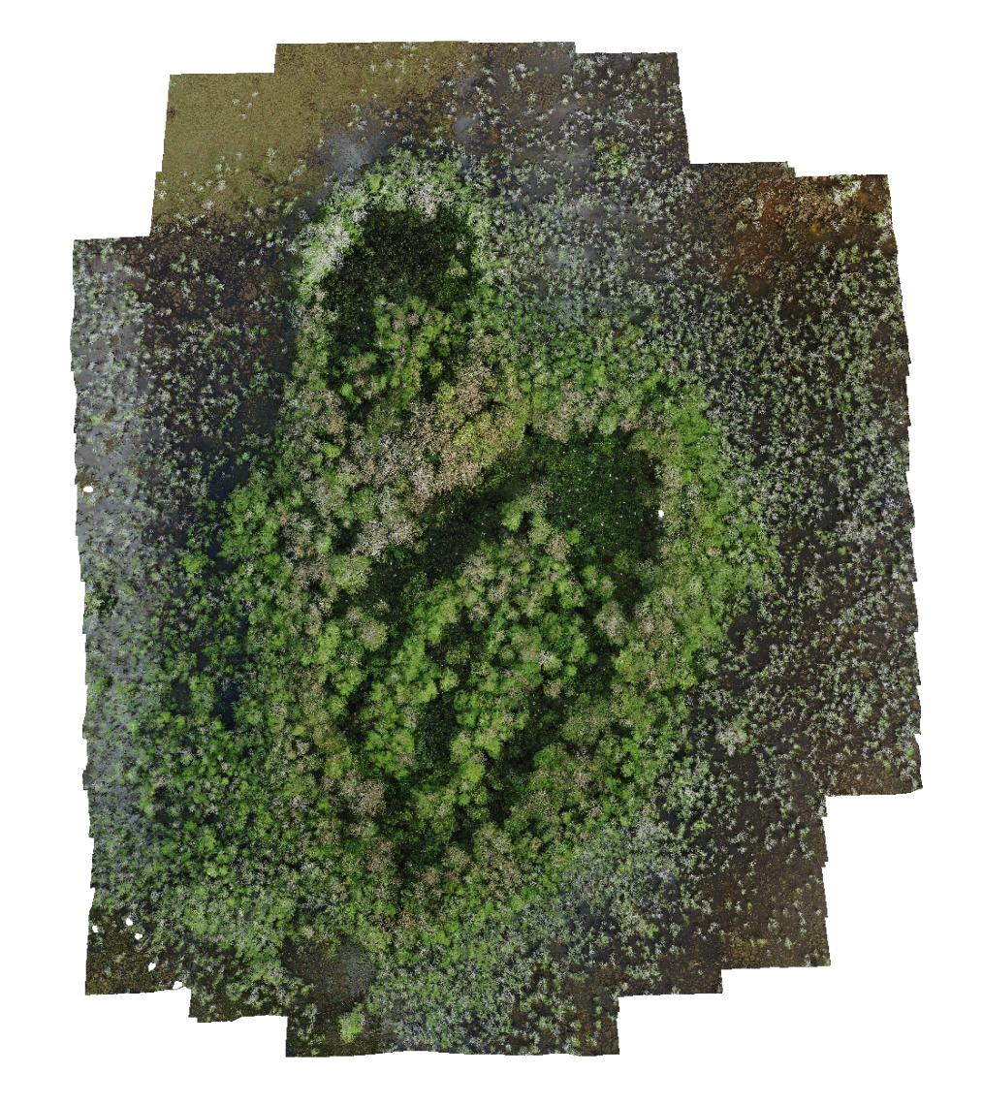
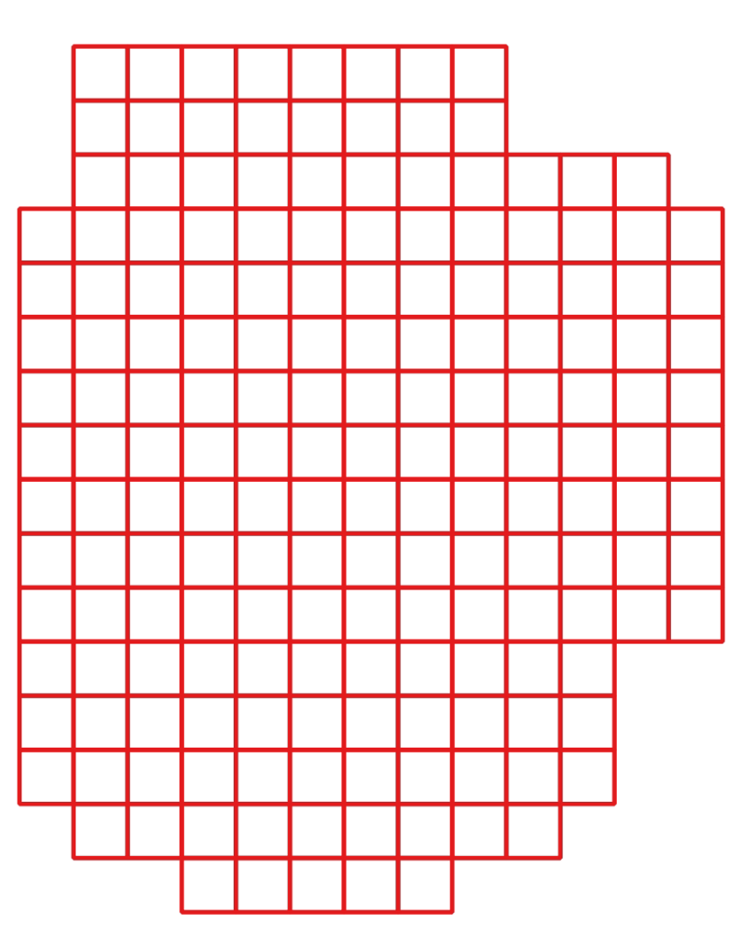

Slide 4
values
mean
xth percentile

Slide 5
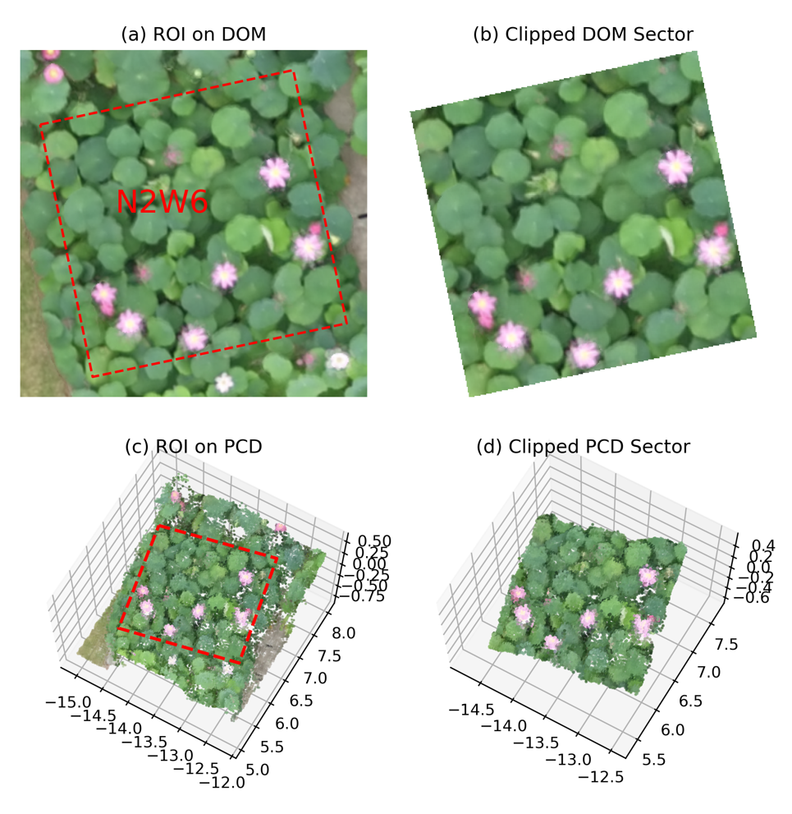

Slide 6
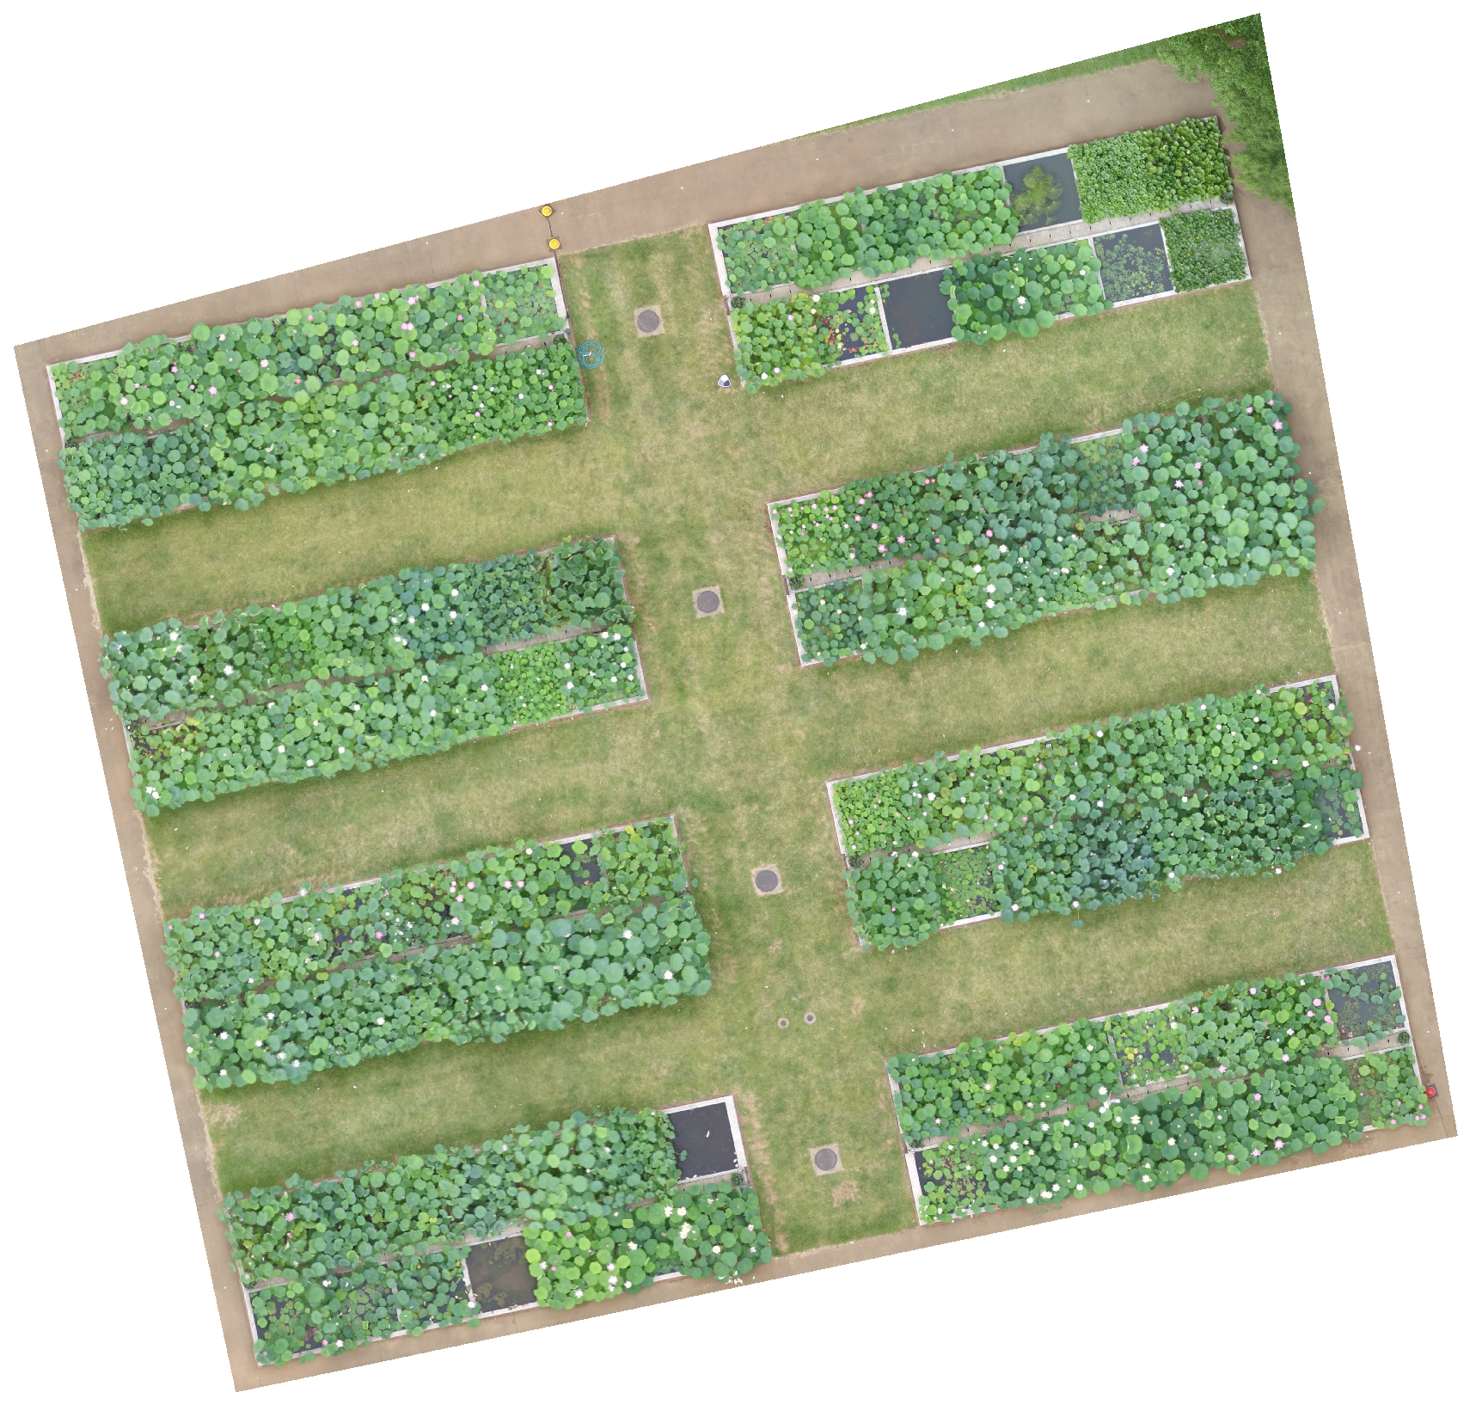
DOM
ROI

Slide 7
Pixel Coordinate on raw image (x, y)
DOM
Geolocations (Lon, Lat)

